Slide 1
Welcome
CS771: Introduction to Machine Learning

Slide 2
Course Details
Number: CS771
Name/Title: Introduction to Machine Learning
Admin Team: TBA
Website: https://tinyurl.com/ml22-23sw
Videos (YouTube): https://tinyurl.com/mlxx-yyzv
Discussion (Piazza): https://tinyurl.com/ml22-23sd
Slides, code, notes (GitHub): https://tinyurl.com/mlxx-yyzc

Slide 3
Auditors
Please email the instructor purushot@cse.iitk.ac.in to get enrolled
Auditors will have access to
Lecture videos, slides, code, notes
Assignment, quiz and exam questions and solutions
We regret our inability to extend the following services to auditors
Submit assignments and receive graded submissions
Appear for quizzes, examinations and receive graded answer scripts

Slide 4
Grading Scheme
30%: Assignments
30%: Mid-sem Exam
40%: End-sem Exam

Slide 5
Assignments – 30%
Two mini projects (weightage TBA)
Replaces the single semester-long project in previous offerings of CS771
To be done in groups of 4-6 students each – 2-3 weeks for each project
Start forming your group today
Will ask you to submit group details once late registration is over
Groups can only contain registered students (no auditors)
Create a homepage on CC/CSE home servers
Essential for project submission
Submission will include code + report
Code should be in Python – start learning Python today
Report should be in LaTeX – start learning LaTeX today

Slide 6
Reference Material
No single textbook for the course
List of reference material is up on course website
Python Resources: several available – choose your favourite
www.geeksforgeeks.org/python-programming-language/
LaTeX resources: several available – choose your favourite
www.overleaf.com/learn/latex/Tutorials

Slide 7
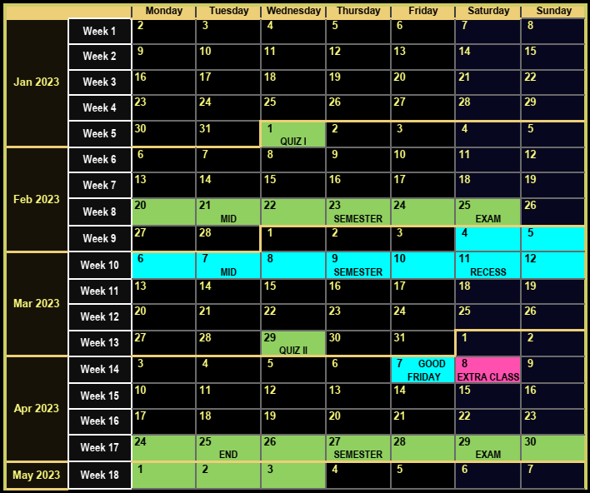





Course Website
Detailed syllabus for this course
Course calendar: schedule for holidays, exams, quizzes
Course policy: assessment, course drop, make-up
Use of unfair means, penalties and safeguards
Course etiquettes

Slide 8
A Summary of To-Dos for You
Everybody
Refresh your calculus, probability theory, linear algebra basics
Start learning/refreshing Python and LaTeX skills
Create a homepage on CC/CSE home servers
Students who are already registered
Start forming groups of 4-6 students – do not wait long
Students who wish to audit
Send an email to the instructor if not already done so
Students who wish to credit
Apply during late registration with DoAA office

Slide 9
A Teaser
What is the point of machine learning?
A few cool ML apps developed by your peers

Slide 10
What is the point of ML anyway?
“
“
The art and science of designing adaptive algorithms
ML is a way to uncover hidden patterns in data
ML is a way to automate tedious and repetitive tasks
ML is a way to predict the future by looking at the past
At a high-level ML does this by
Looking at lots of data to examine input-output behaviour
Replicate that behaviour by writing a program

Slide 11









Machine Learning
“
“
The art and science of designing adaptive algorithms
A Non-adaptive Algorithm
Sorting: given $n$ numbers, sort them in decreasing order of their value
An Adaptive Algorithm
Recommendation: given a person John and$n$ items, sort items in decreasing order of how much John likes them
INPUT
OUTPUT
INPUT
OUTPUT
4
9
5
5
1
7
-6
4
5
5
4
1
9
4
-3
0
ML can help you learn patterns that allow you to sort the same set of items differently for each person according to their taste
3
3
-2
-2
7
2
1
-3
2
1
0
-6

Slide 12
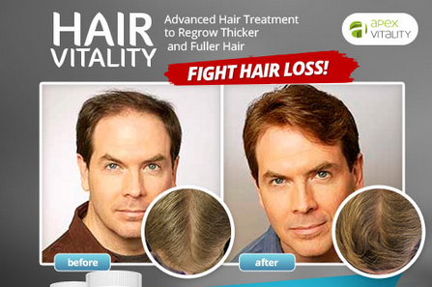
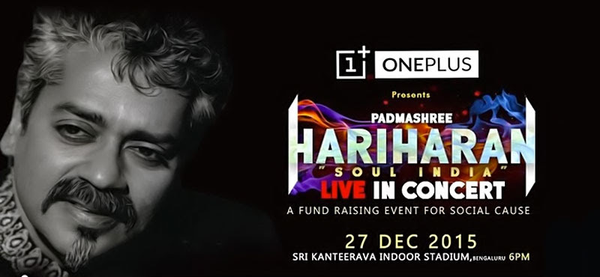
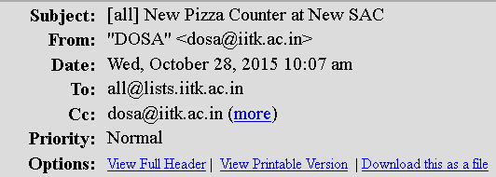
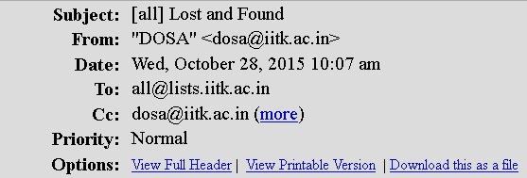
Machine Learning
“
“
The art and science of designing adaptive algorithms

Slide 13
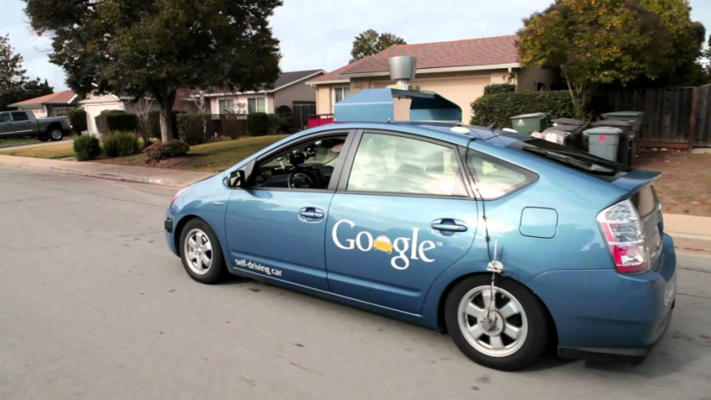
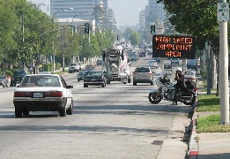
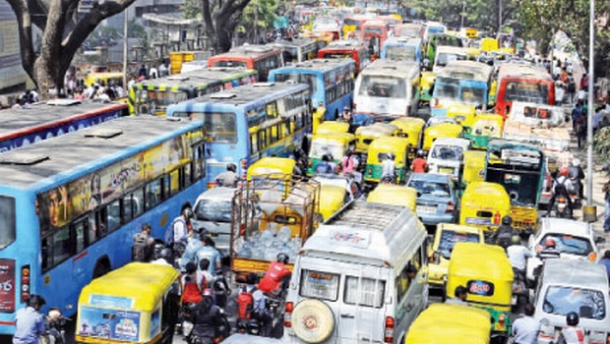
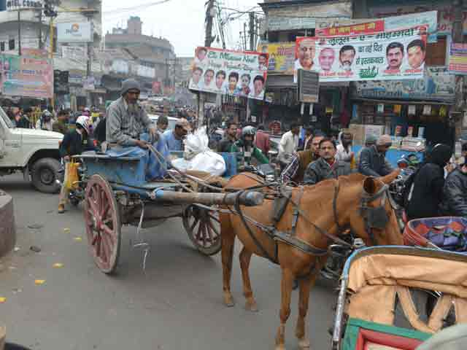
Machine Learning
“
“
The art and science of designing adaptive algorithms

Slide 14










When to apply ML
Complexity: no “closed form” solutions
Humans cannot specify simple rules to get solution
Detecting spelling mistakes not a good ML problem
A simple dictionary lookup (binary search) is enough
Presence of immense variety
Too many variants to be solved independently
Correcting spelling mistakes a very good ML problem
Need for automation
Scalability and speed are main criterion
Do we need to automate medicine, driving?
macine
macine
machine

Slide 15



Slide 16


Must authenticate your sensors so that tampering can be detected!
Couldn’t you have told me earlier?!

Slide 17


Authentication by Secret Questions
Give me your A/C number and answer the following questions
What is your date of birth?
What is your pet’s name?
How many marks did you get in 10th standard exams?
How many cars do you own?
…
SBI31415926535
05th August 2000
Mr. Bud Bud
err … couldn’t hear you clearly
None, so give me that loan already!
…
BANK
USER

Slide 18

Authentication by Secret Questions
Using PUFs
Give me your device ID and answer the following questions
10111100
00110010
10001110
00010100
…
TS271828182845
1
0
1
0
…
SERVER
DEVICE
How to ensure that these answers are unique and unpredictable?

Slide 19


Physically Unclonable Functions
0.50ms
These tiny differences are difficult to predict or clone
0.55ms
Then these could act as the fingerprints for the devices!

Slide 20

A simple Multiplexer PUF
Multiplexers are basically switching circuits
“select” bit
0
1
Correct. However, the devices are consistent, i.e., their delays do not change (too much) over time.
p ms delay
r ms delay
s ms delay
q ms delay
It is difficult to deliberately create another mux that exhibits the same delays

Slide 21
Arbiter PUFs
If the top signal reaches the finish line first, the “answer” to this question is 0, else if the bottom signal reaches first, the “answer” is 1
Question: 1011
1
0
1
1
?

Slide 22
Arbiter PUFs
If the top signal reaches the finish line first, the “answer” to this question is 0, else if the bottom signal reaches first, the “answer” is 1
Question: 1011
1
0
1
1
1
?

Slide 23
Arbiter PUFs
If the top signal reaches the finish line first, the “answer” to this question is 0, else if the bottom signal reaches first, the “answer” is 1
Question: 0110
0
1
1
0
0
?

Slide 24


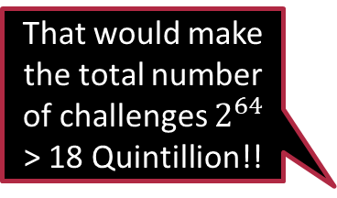
Some FAQs
Does it matter whether the “red” signal reaches first or the “blue”?
No, the color does not matter – the color was added just for explanation
Why go into all this fuss of having multiple multiplexers?
It was expected that it would make it more difficult to predict the answers. Also, it increases the number of possible questions.
Is it compulsory to have only 4 multiplexers?
Absolutely not. It depends on how long are your “questions”
That would make the total number of challenges $2^{64}$ > 18 Quintillion!!
It is common to have 64 multiplexers
Good … even if an attacker knows the responses to a few challenges, there is no way to guess the other answers. Right? Right? Hello! Melbo!!
By the way, people usually call the questions “challenges” and the answers “responses”
Actually …

Slide 25









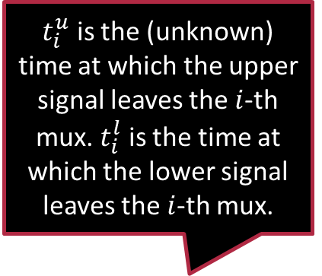






















A Twist in the Tale
$t_{i}^{u}$ is the (unknown) time at which the upper signal leaves the $i$-th mux. $t_{i}^{l}$ is the time at which the lower signal leaves the $i$-th mux.
An attacker can see responses on a few challenges and use ML to predict responses on all other challenges ☹
Does not matter if using 32-bit or 64-bit challenges
All mux-es are different so $p_{1}≠p_{2}≠…,q_{1}≠q_{2}≠…$
$$c_{0}$$
$$c_{1}$$
$$c_{2}$$
$$c_{63}$$
$$t_{0}^{u}$$
$$t_{1}^{u}$$
$$…$$
$$t_{2}^{u}$$
$$t_{63}^{u}$$
$$p_{0}$$
$$p_{1}$$
$$p_{2}$$
$$p_{63}$$
$$r_{0}$$
$$r_{1}$$
$$r_{2}$$
$$r_{63}$$
$$s_{0}$$
$$s_{1}$$
$$s_{2}$$
$$…$$
$$t_{0}^{l}$$
$$t_{1}^{l}$$
$$t_{2}^{l}$$
$$s_{63}$$
$$t_{63}^{l}$$
$$q_{0}$$
$$q_{1}$$
$$q_{2}$$
$$q_{63}$$

Slide 26

A Twist in the Tale
Observe that the answer is $0$ if $t_{63}^{u}<t_{63}^{l}$ and $1$ otherwise
Also note that $t_{1}^{u}$ and $t_{1}^{l}$ depend on $t_{0}^{u},t_{0}^{l},p_{1},q_{1},r_{1},s_{1}$ and $c_{1}$
$c_{1}$ dictates which previous delay $t_{0}^{u}$ or $t_{0}^{l}$ will get carried forward in which branch, and $p_{1},q_{1},r_{1},s_{1}$ give us the delay introduced by the $1$-th mux itself
$$c_{0}$$
$$c_{1}$$
$$c_{2}$$
$$c_{63}$$
$$t_{0}^{u}$$
$$t_{1}^{u}$$
$$…$$
$$t_{2}^{u}$$
$$t_{63}^{u}$$
$$p_{0}$$
$$p_{1}$$
$$p_{2}$$
$$p_{63}$$
$$r_{0}$$
$$r_{1}$$
$$r_{2}$$
$$r_{63}$$
$$s_{0}$$
$$s_{1}$$
$$s_{2}$$
$$…$$
$$t_{0}^{l}$$
$$t_{1}^{l}$$
$$t_{2}^{l}$$
$$s_{63}$$
$$t_{63}^{l}$$
$$q_{0}$$
$$q_{1}$$
$$q_{2}$$
$$q_{63}$$

Slide 27
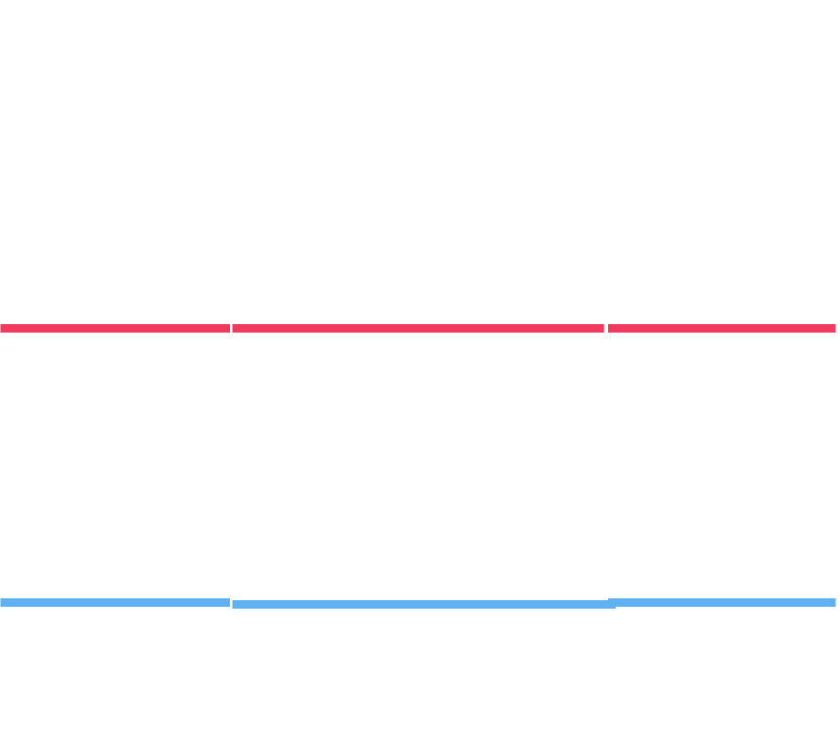
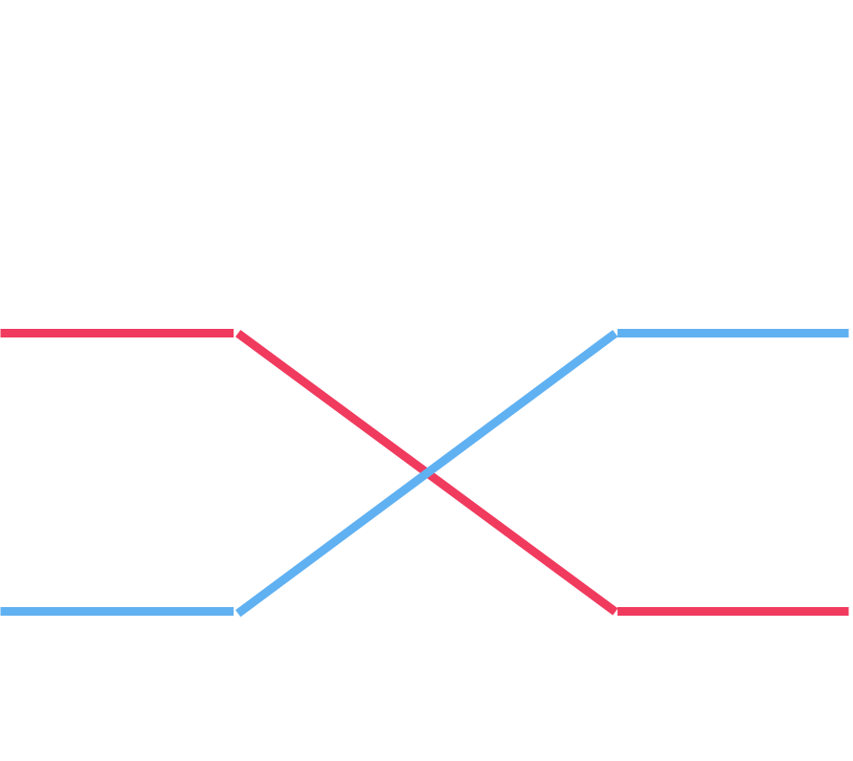











A Twist in the Tale
$$0$$
$$1$$
$$1$$
$$0$$
$t_{1}^{u}=\left(1−c_{1}\right)⋅\left(t_{0}^{u}+p_{1}\right)+c_{1}⋅\left(t_{0}^{l}+s_{1}\right)$
$t_{1}^{l}=\left(1−c_{1}\right)⋅\left(t_{0}^{l}+q_{1}\right)+c_{1}⋅\left(t_{0}^{u}+r_{1}\right)$
$$1$$
$$0$$
$$1$$
$$0$$
$$c_{0}$$
$$c_{1}$$
$$c_{2}$$
$$c_{63}$$
$$0$$
$$1$$
$$t_{0}^{u}$$
$$t_{1}^{u}$$
$$…$$
$$t_{2}^{u}$$
$$t_{63}^{u}$$
$$p_{0}$$
$$p_{1}$$
$$p_{2}$$
$$p_{63}$$
$$r_{0}$$
$$r_{1}$$
$$r_{2}$$
$$r_{63}$$
$$s_{0}$$
$$s_{1}$$
$$s_{2}$$
$$…$$
$$t_{0}^{l}$$
$$t_{1}^{l}$$
$$t_{2}^{l}$$
$$s_{63}$$
$$t_{63}^{l}$$
$$q_{0}$$
$$q_{1}$$
$$q_{2}$$
$$q_{63}$$

Slide 28
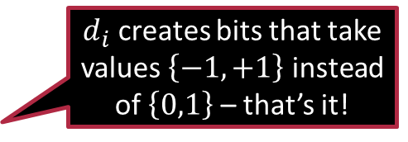

A little bit of Math ☺
Let us use the shorthand $Δ_{i}=t_{i}^{u}−t_{i}^{l}$ to denote the lag
Recall: all that matters is whether the top signal reaches first or not
Thus, all that matters is whether $Δ_{63}<0$ or not
$Δ_{1}=\left(1−c_{1}\right)⋅\left(t_{0}^{u}+p_{1}−t_{0}^{l}−q_{1}\right)+c_{1}⋅\left(t_{0}^{l}+s_{1}−t_{0}^{u}−r_{1}\right)$
$=\left(1−c_{1}\right)⋅\left(Δ_{0}+p_{1}−q_{1}\right)+c_{1}⋅\left(−Δ_{0}+s_{1}−r_{1}\right)$
$=\left(1−2c_{1}\right)⋅Δ_{0}+\left(q_{1}−p_{1}+s_{1}−r_{1}\right)⋅c_{1}+\left(p_{1}−q_{1}\right)$
To make notation simpler, let $d_{i}≝\left(1−2c_{i}\right)$
$Δ_{1}=Δ_{0}⋅d_{1}+α_{1}⋅d_{1}+β_{1}$ $α_{1}=\left(p_{1}−q_{1}+r_{1}−s_{1}\right)/2$ $β_{1}=\left(p_{1}−q_{1}−r_{1}+s_{1}\right)/2$
$d_{i}$ creates bits that take values $\left\{−1,+1\right\}$ instead of $\left\{0,1\right\}$ – that’s it!

Slide 29

A little bit of Math ☺
Note that a similar relation holds for any stage $Δ_{i}=d_{i}⋅Δ_{i−1}+α_{i}⋅d_{i}+β_{i}$
where $α_{i}=\left(p_{i}−q_{i}+r_{i}−s_{i}\right)/2$ and $β_{i}=\left(p_{i}−q_{i}−r_{i}+s_{i}\right)/2$
We can safely take $Δ_{−1}=0$ (absorb initial delays into $p_{0},q_{0},r_{0},s_{0}$)
We can keep going on recursively $Δ_{0}=α_{0}⋅d_{0}+β_{0}$ (since $Δ_{−1}=0$)
$Δ_{1}=Δ_{0}⋅d_{1}+α_{1}⋅d_{1}+β_{1}$ – now plugin value of $Δ_{0}$ to get
$Δ_{1}={α_{0}⋅d}_{1}⋅d_{0}+\left(α_{1}+β_{0}\right)⋅d_{1}+β_{1}$
$Δ_{2}=α_{0}⋅d_{2}⋅d_{1}⋅d_{0}+\left(α_{1}+β_{0}\right)⋅d_{2}⋅d_{1}+\left(α_{2}+β_{1}\right)⋅d_{2}+β_{2}$
We can begin to see a pattern here

Slide 30



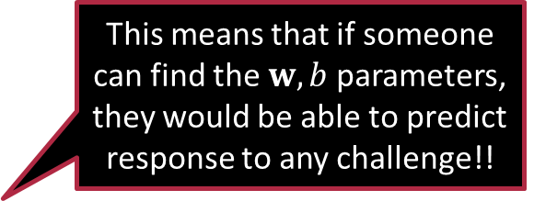
Linear Models
We have $Δ_{63}=w_{0} ⋅x_{0}+w_{1}⋅x_{1}+…+w_{63}⋅x_{63}+β_{63}=w^{⊤}x+b$
where $x_{i}=d_{i}⋅d_{i+1}⋅…⋅d_{63}$ $w_{0}=α_{0}$ $w_{i}=α_{i}+β_{i−1} \left(for i>0\right)$
If $Δ_{63}<0$, upper signal wins and answer is 0
If $Δ_{63}>0$, lower signal wins and answer is 1
Thus, answer is simply $\frac{sign\left(w^{⊤}x+b\right)+1}{2}$
Exactly, this is why people stopped using arbiter PUFs for authentication after this was revealed
This means that if someone can find the $w,b$ parameters, they would be able to predict response to any challenge!!
This is nothing but a linear classifier!

Slide 31


Linear/hyperplane Classifiers
The model is a single vector $w$ of dimension $d$ (features are also $d$-dim), and a scalar term (called bias) $b$
Predict on a test point $x$ by checking if $w^{⊤}x+b>0$
Decision boundary: hyperplane (where $w^{⊤}x+b=0$)
The vector $w$ is called the normal or perpendicular vector of the hyperplane – why?
Consider any two vectors $x,y$ on the hyperplane i.e. $w^{⊤}x+b=0=w^{⊤}y+b$. This means $w^{⊤}(x−y)=0$. Note that the vector $x−y$ is parallel to the hyperplane and $w$ perpendicular to all such vectors
The bias term $b$ if changed, shifts the plane – it can be thought of as a threshold as well – how large does $w^{⊤}x$ have to be in order for decision to be 1
$$w$$

Slide 32
Stay Awesome!
See you in the next one

